Slide 1
23 – Clean Code – Advanced TDD Mocking
Based on the CleanCoders videos by Uncle Bob Martin
Rupert Waldron

Slide 2
Test Driven Development - Refresh
We saw in the original presentation how code rots, becomes fragile and rigid. Changes take for ever and often require changes to many modules and break unexpected parts of the cause, or cause unexpected behaviors.
Solution… clean the code
We don’t clean it because we are afraid we would break it… and if you break it, it will become yours!!
We need to eliminate the FEAR

Slide 3
Eliminating the fear
With a fantastic test suite… created using Test Driven Development

Slide 4
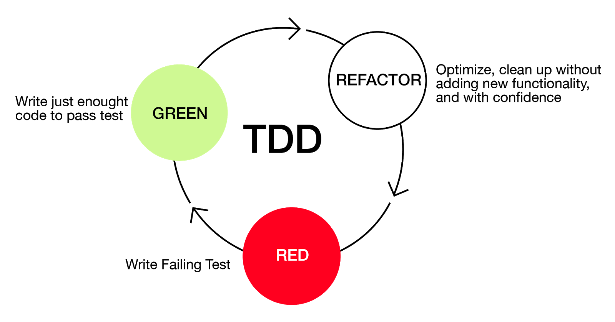

The Three Laws of TDD
Not compiling is also failing
Start here

Slide 5
Some of the benefits
Writing tests firsts makes production code testable – this means to code will naturally be de-coupled
You are only a few minutes away from fully working code as each cycle should only take a few minutes
You have ready to go documentation because all the use of the code is demonstrated by the test suite.
Think of testing as double entry book-keeping – accounting is subject to single digit errors – just like software.

Slide 6
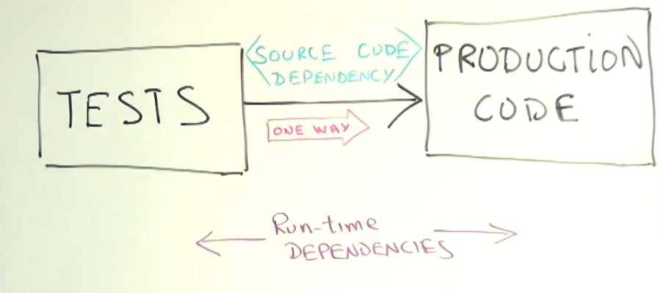
Advanced TDD
The tests are dependent on the production code… not the other way around
Kent Beck says:
First make it work
Then make it right
Then make it fast and small

Slide 7
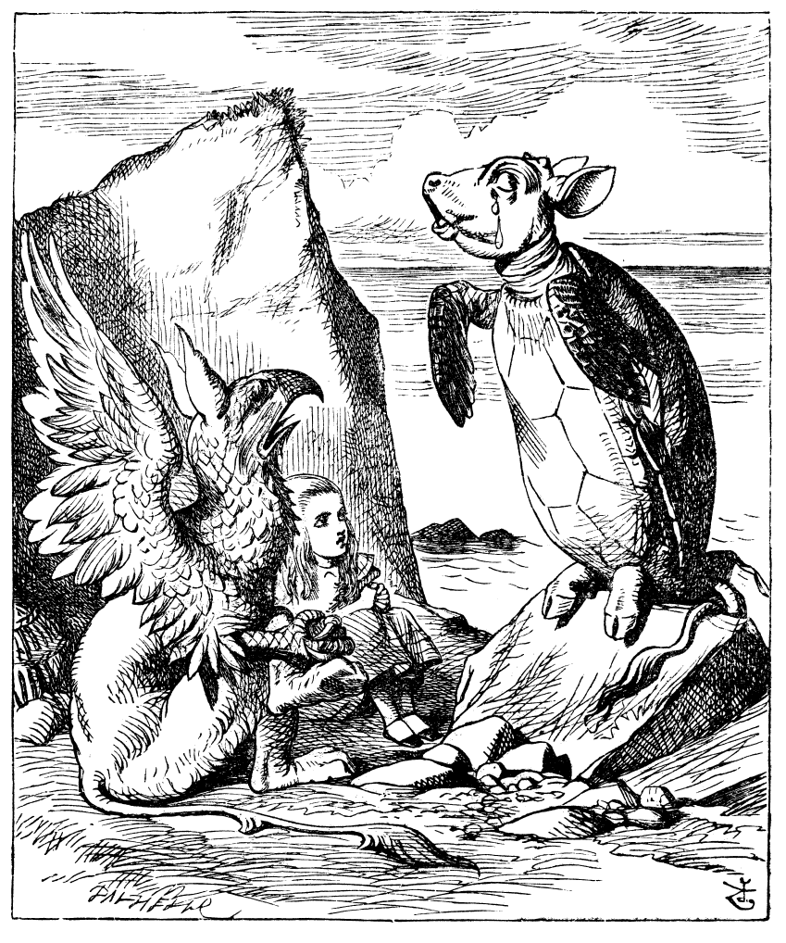
Advanced TDD - Mocking
Mock Turtle from Alice in Wonderland… came from the substitute meat (cheaper) that was used in the soup instead of the actual Green turtle meat.

Slide 8
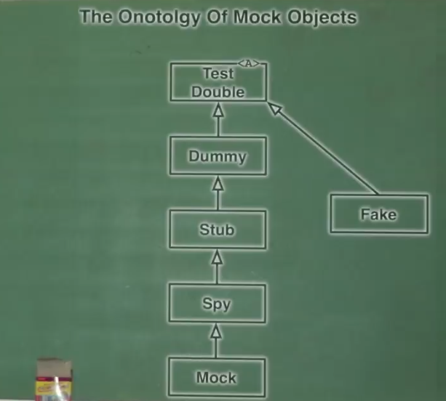
Onotolgy of Mock objects
Notice the Test Double is abstract, there is no such thing as a pure test double
Also notice the Is-A relationship between the test doubles

Slide 9

The Dummy
The most basic – does nothing returns nothing useful.
All functions perform no actions and return 0 or as close to null as possible. Used when a method takes an argument which isn’t tested, but just needs the dummy to run the code
See the code

Slide 10
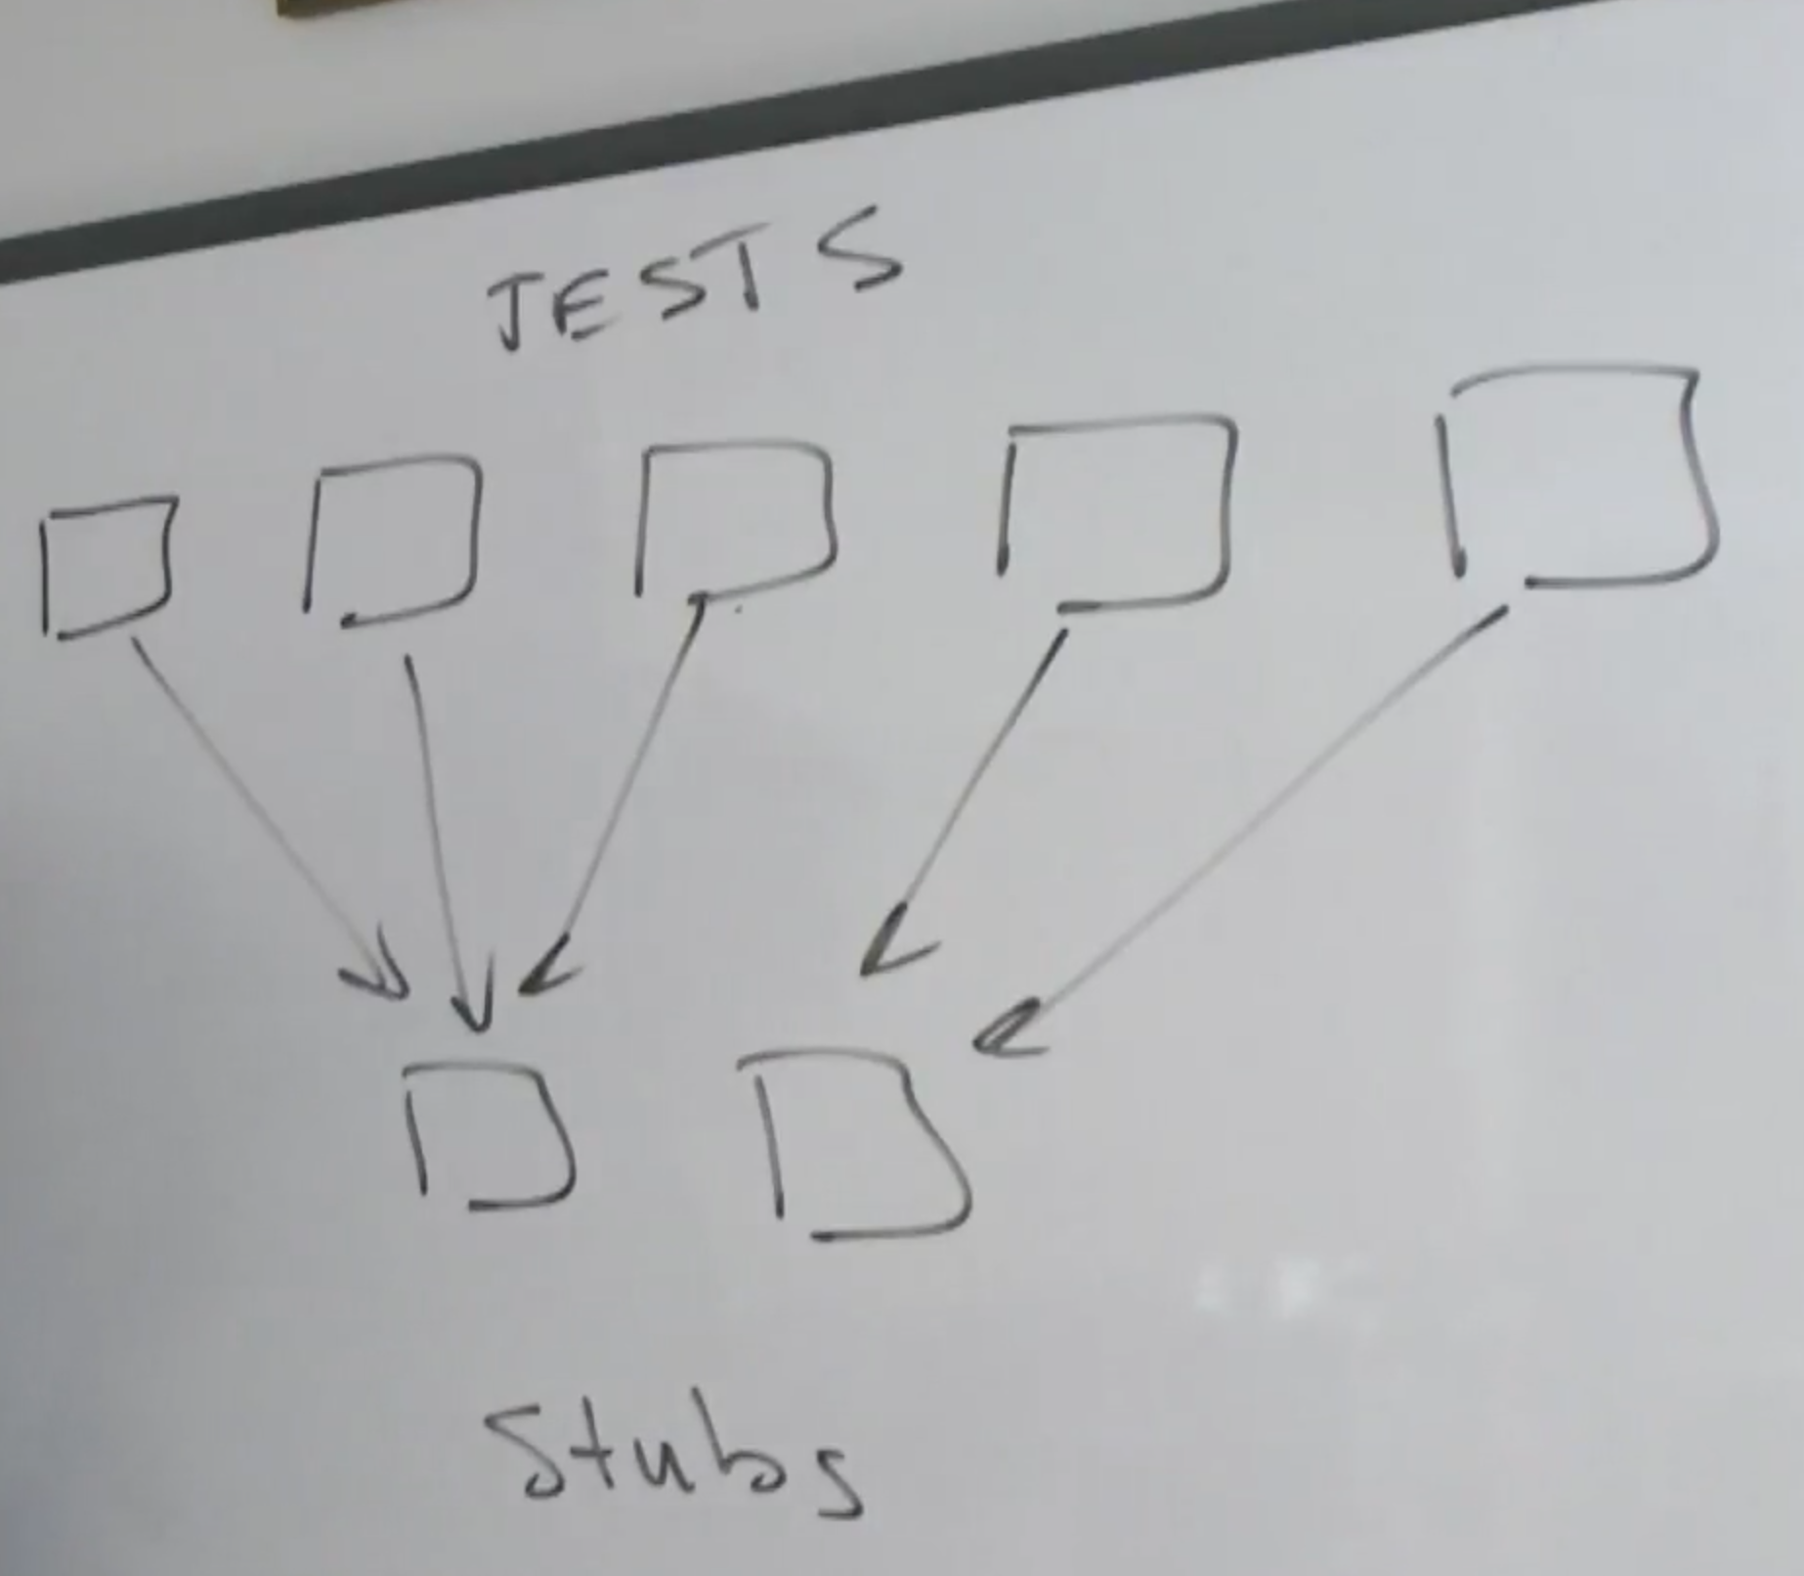

The Stub
The Stub is a Dummy which does nothing… but instead of returning null or zero like a Dummy, it will return a value. A value that is consistent with the needs of the test.
The tests will choose a particular stub that will force the code through a particular pathway
See the code

Slide 11
The Spy
The Spy is just a Stub does nothing, but returns values useful to the test. However, the Spy remembers facts about the way in which it was called and reports those facts back
Spies are useful to tell if a function was called and how many times a function was called
Spies are useful to find out what arguments are passed in.
See the code

Slide 12
The true Mock
The true Mock is a Spy (it’s functions do nothing, but it returns values that are useful to the test, and remembers interesting facts about the way it was called). But the true Mock’s special feature is that it knows what should happen
The test asks the true Mock if everything went the way it was supposed to.
The test trusts the true Mock.
See the code
assertThat(authorizerMock.verifyHeldOnThirdAttempt("username")).isTrue();

Slide 13
The Fake
The Fakes are simulators. In the days before TDD and you had an external service you would often replace that service with a simulator that acted like that service.
The Fakes can get very complicated to the point where you need tests for your Fake. You should be able to do most of your testing without a Fake – Useful for Integration Tests, but avoid if possible
The Fake has more logic in it – it pretends to have some realistic behaviour
public class FakeAuthorizer implements Authorizer { public UserID authorize(String username, String password) { if (username.toLowerCase().startsWith("good")) return new UserID(1); else return new InvalidUserID(); } public void hold(String username) { } }
See the code

